Slide 1
Eudicots-- Rosids
Judd et al pp. 335-407

Slide 2
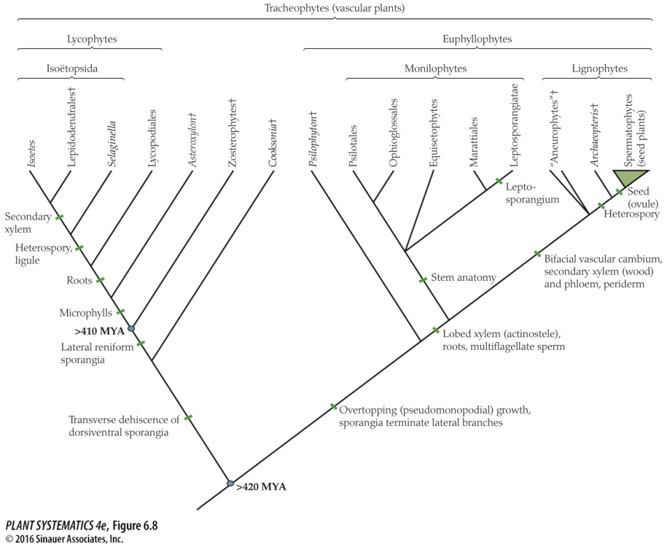
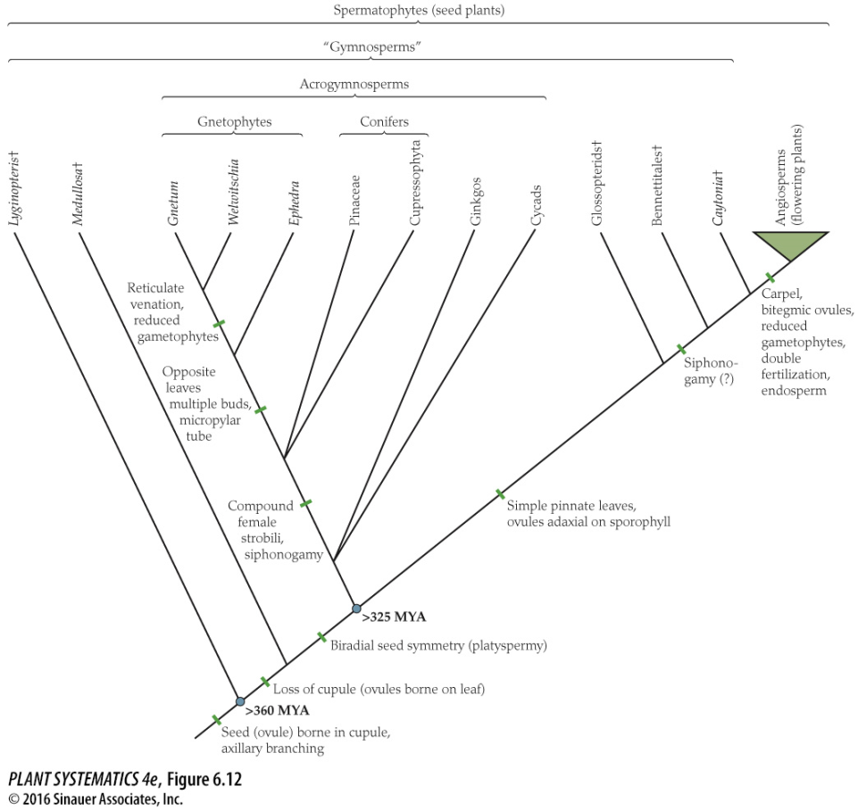
Remember the really big picture…
Mosses, Liverworts, Hornworts
Algae

Slide 3
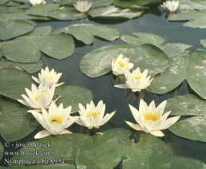
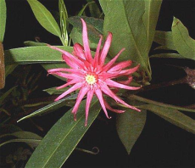
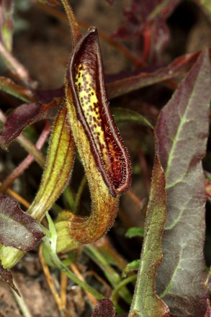
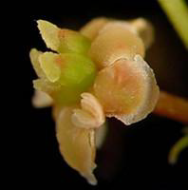
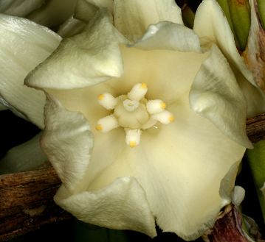
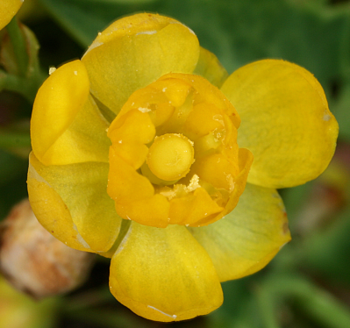
Magnoliids
Monocots
Amborella
Nymphaeales
Austrobaileyales
ANA Grade
Remember the big picture….
Eudicots
Angiosperm Relationships
(simplified)

Slide 4
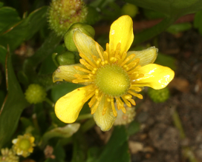
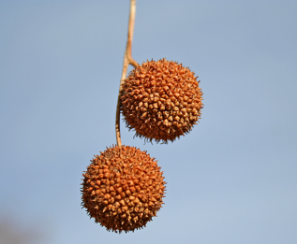
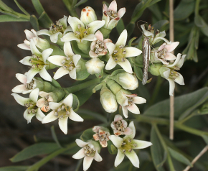
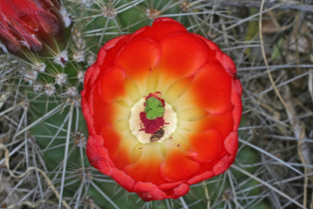
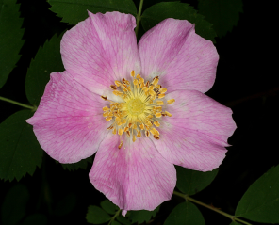
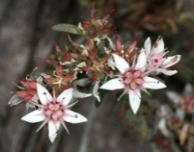
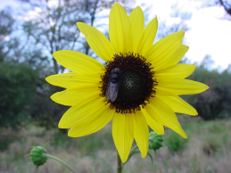
Proteales
Ranunculales
Santalales
Caryophyllales
Rosids
= Vitales + Fabids + Malvids
Saxifragales
Asterids
= Cornales+Ericales+Lamiids+Canpanulids
Superrosids
Superasterids
Basal Eudicots
Simplified Eudicot Phylogeny (Eudicot= Tricolpate)
Core Eudicots

Slide 5
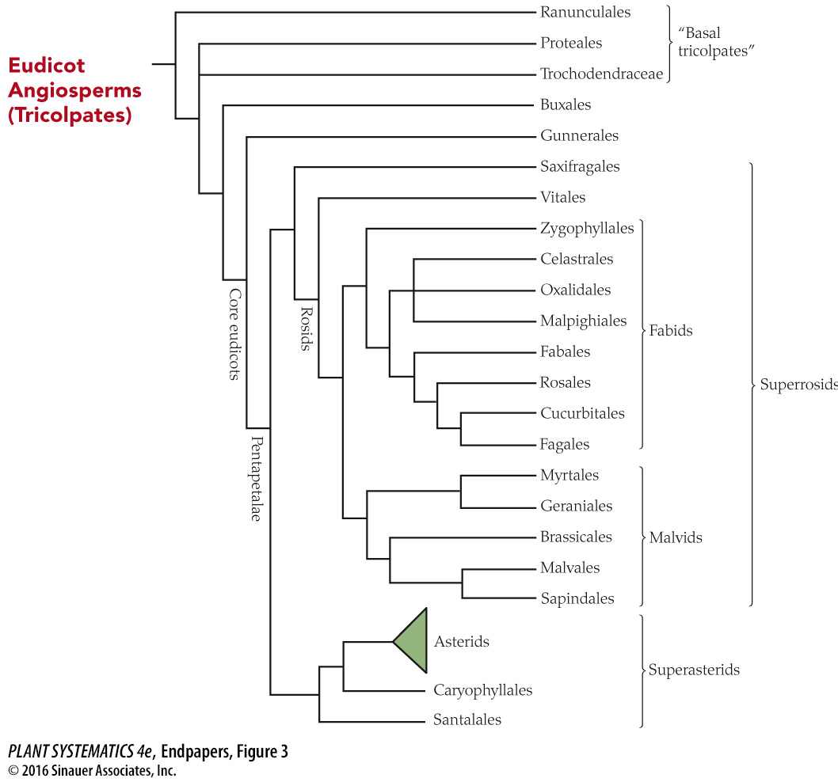
Rosids

Slide 6
Rosid Clade
Large, morphologically heterogenous grouping of orders, made of mostly of two subclades– Fabids (sometimes called rosids I, or eurosids I) and Malvids (sometimes called rosids II, or eurosids II) . (Rosids= Fabids+Malvids+Vitales)
Monophyly mostly based on gene sequences: rbcL, atpB, matK, 18S rDNA

Slide 7
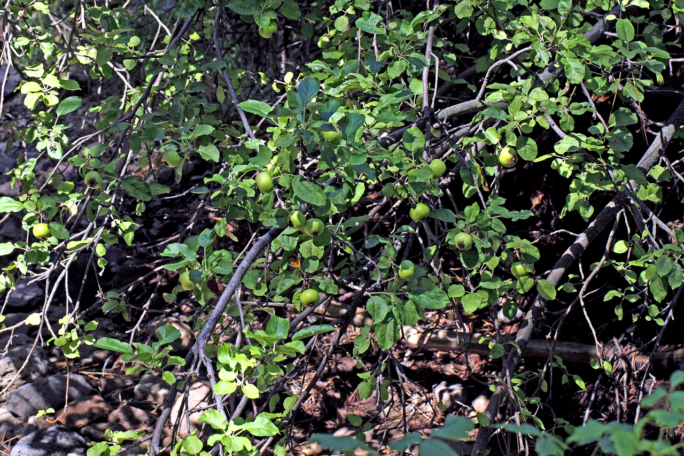
Rosids (Rosaceae)
Malus pumila

Slide 8
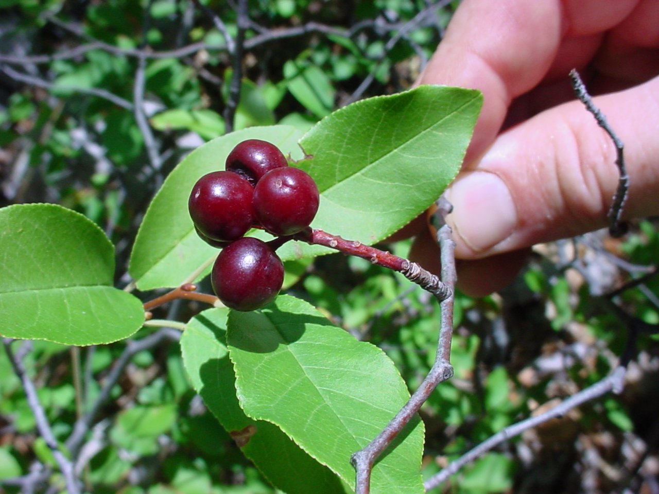
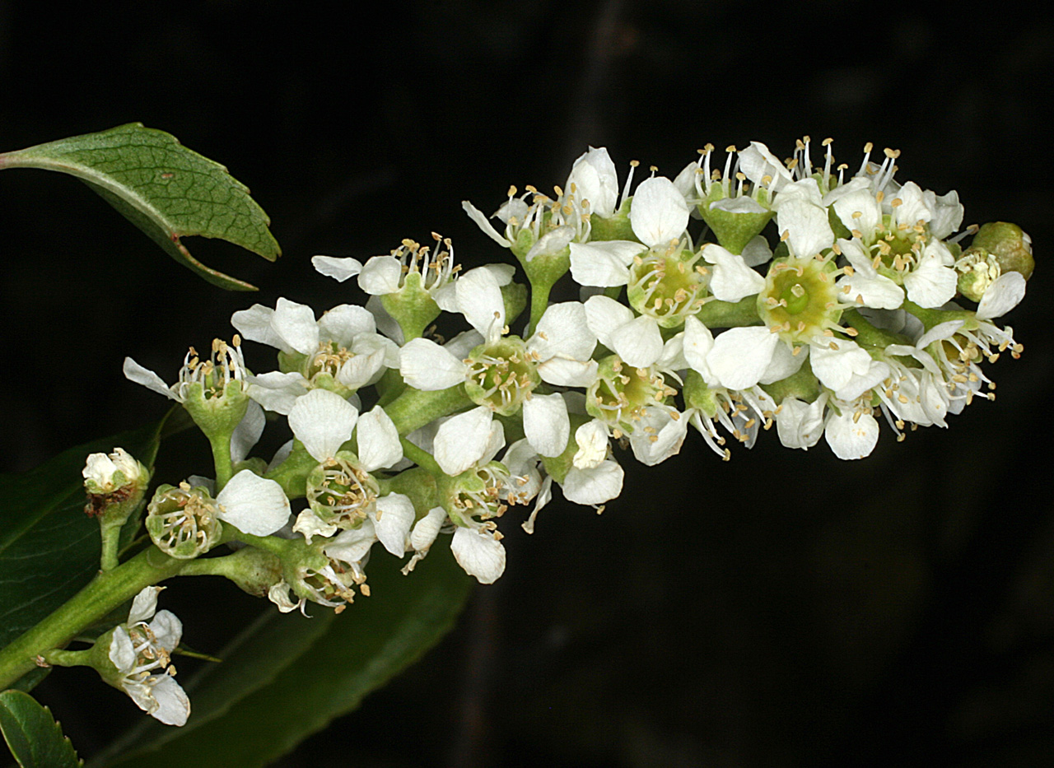
Prunus serotina
Rosids (Rosaceae)

Slide 9
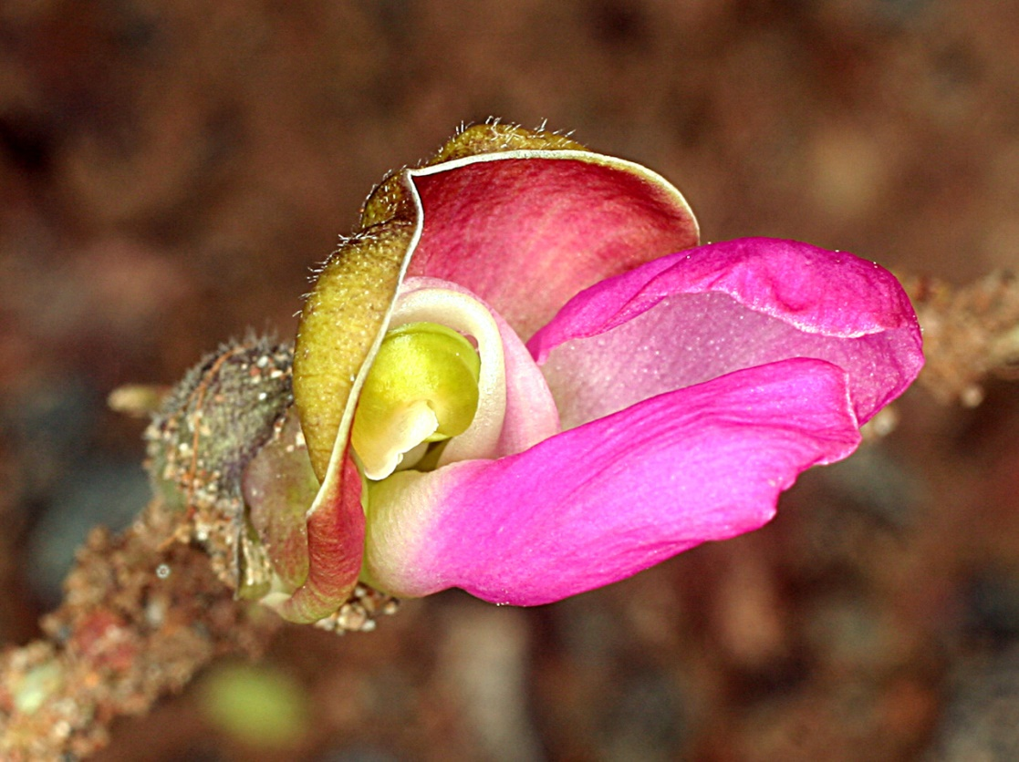
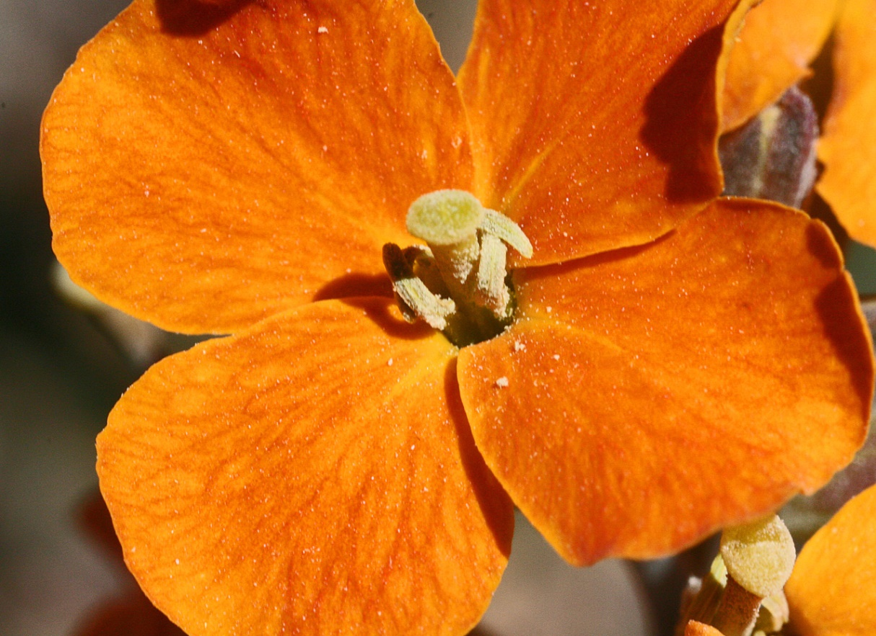
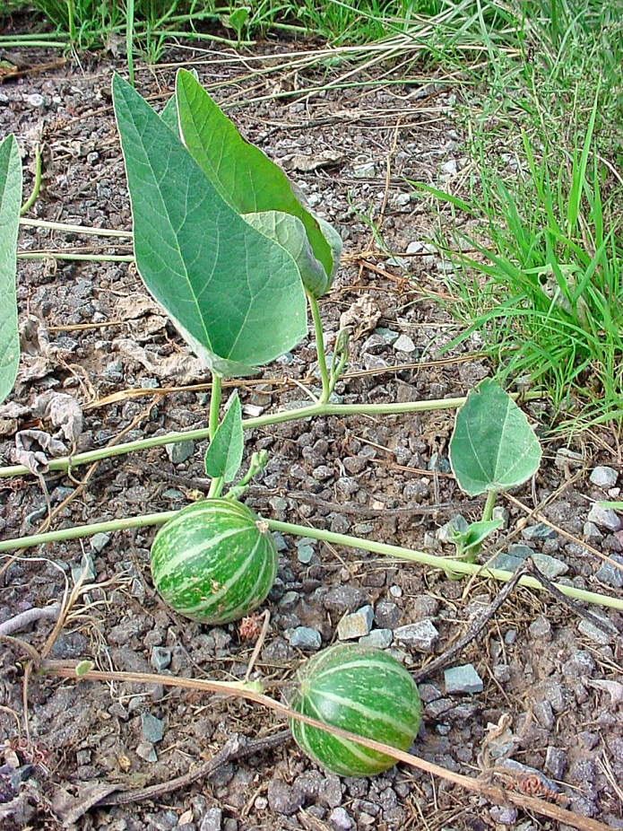
Rosids
Fabaceae: Phaseolus maculatus
Brassicaceae: Erysimum capitatum
Cucurbitaceae: Cucurbita foetidissima

Slide 10
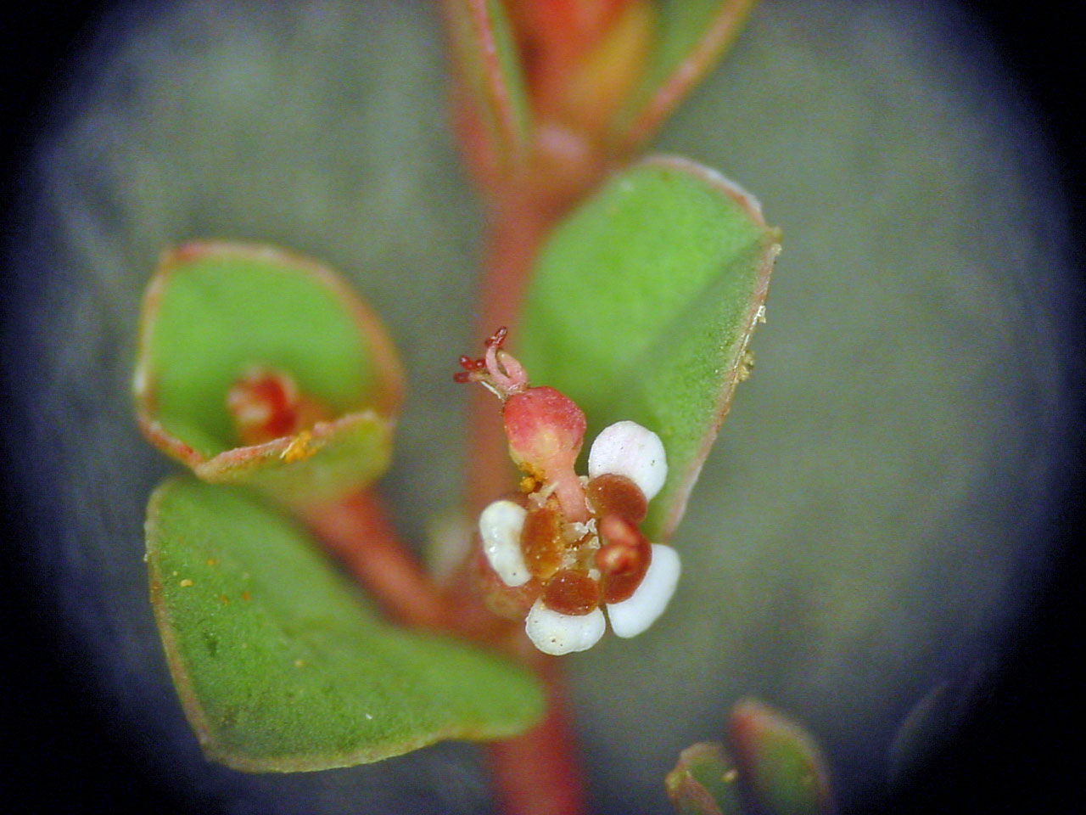
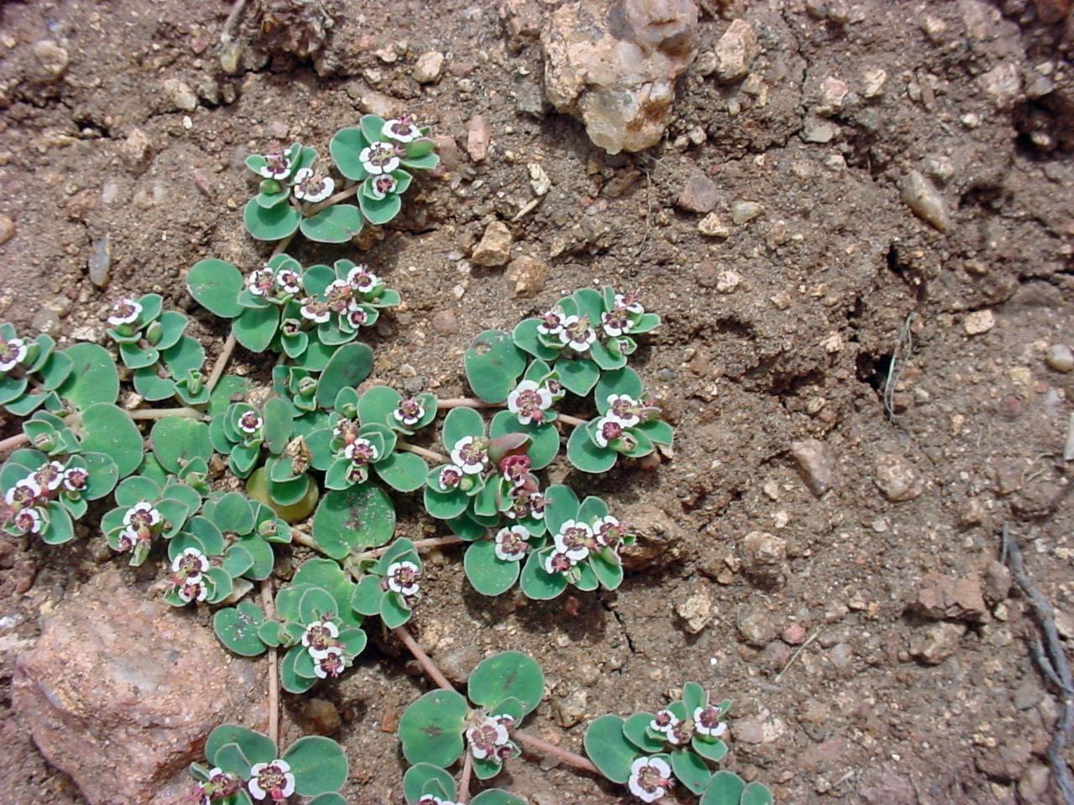
Rosids (Euphorbiaceae)
Chamaecyse albomarginata

Slide 11
Hypothetical Relationships in Rosid Clade

Slide 12
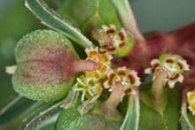
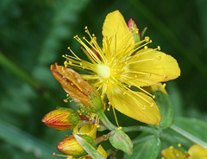
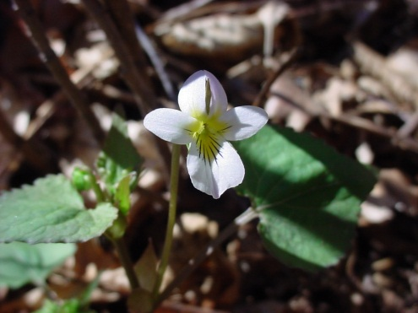
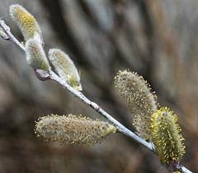
Malpighiales: an Order including several families well represented in the Gila
Euphorbiaceae
Hypericaceae
Violaceae
Salicaceae

Slide 13
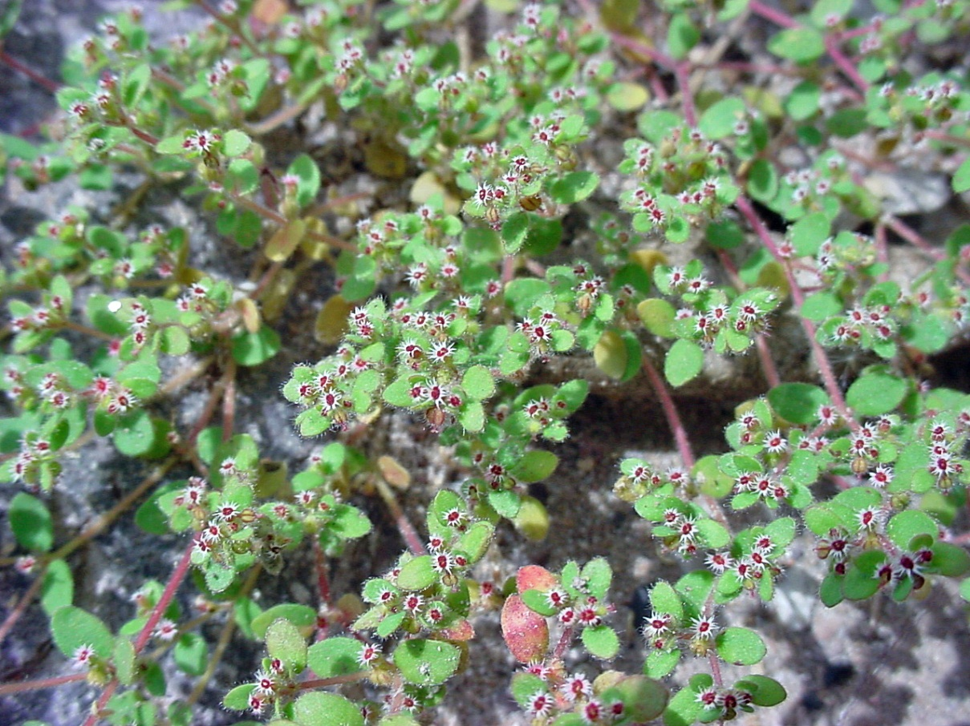
Rosids: Malpighiales: Euphorbiaceae: Euphorbia
Chamaesyce setiloba
Euphoriba davidii

Slide 14
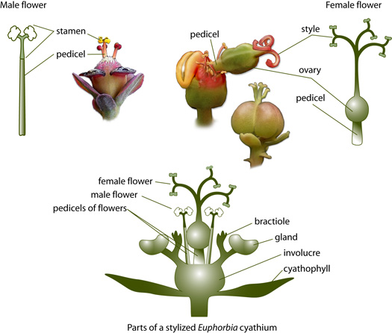
Eudicots: Rosids: Fabids: Malpighiales: Euphorbiaceae

Slide 15
Euphorbiaceae
Euphorbia cuphosperma
Euphorbia brachycera
Cyathium: cuplike inflorescence of species of Euphorbia that mimics a single flower but consists of nectar glands, several staminate flowers and one carpellate flower

Slide 16
Euphorbiaceae: Euphorbia
Trees, shrubs, or herbs, ours usually small and herbaceous, elsewhere can be cactus-like
Foliage—
Calyx—
Corolla—
Androecium—
Gynoecium—
Fruit—
Cyathium, with or without glands and petaloid appendages
Staminate flowers reduced to just a stamen
Three connate carpels
Schizocarp (but sometimes referred to as capsule)

Slide 17
Hypothetical Relationships in Rosid Clade

Slide 18
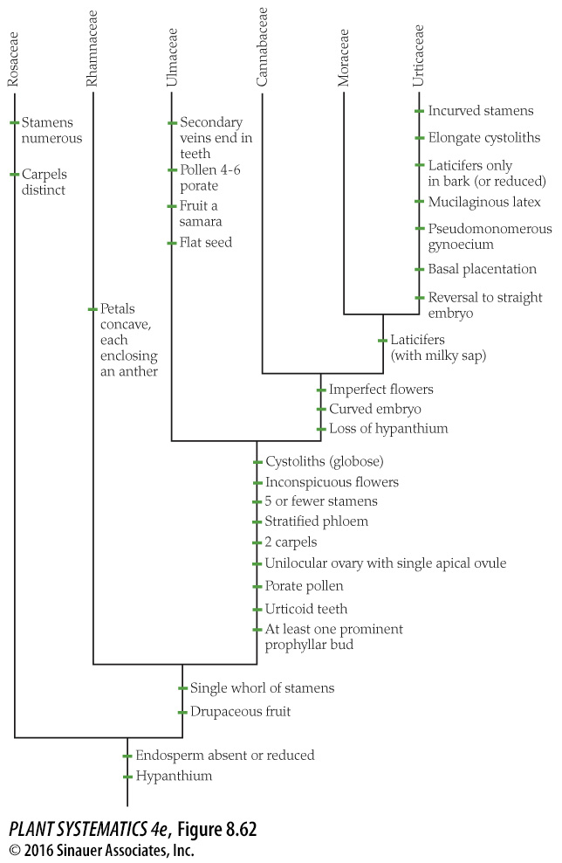
Rosales

Slide 19
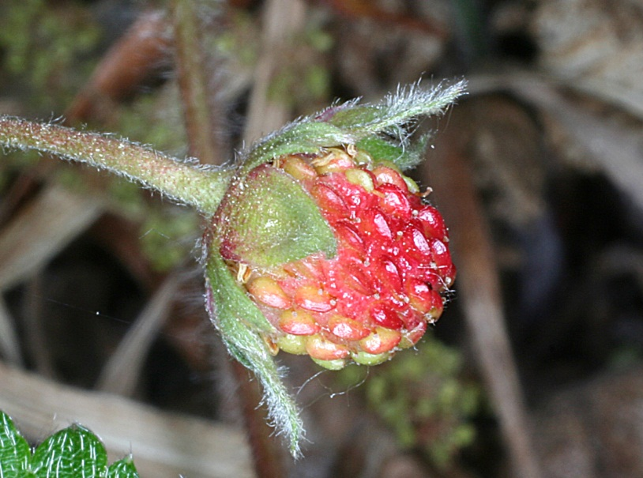
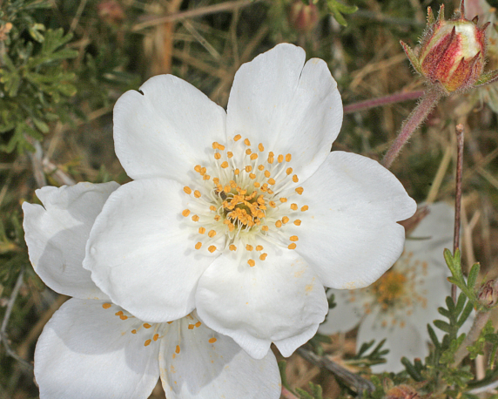
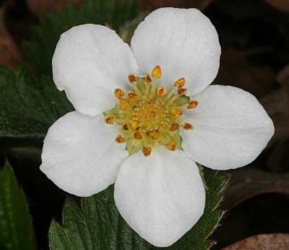
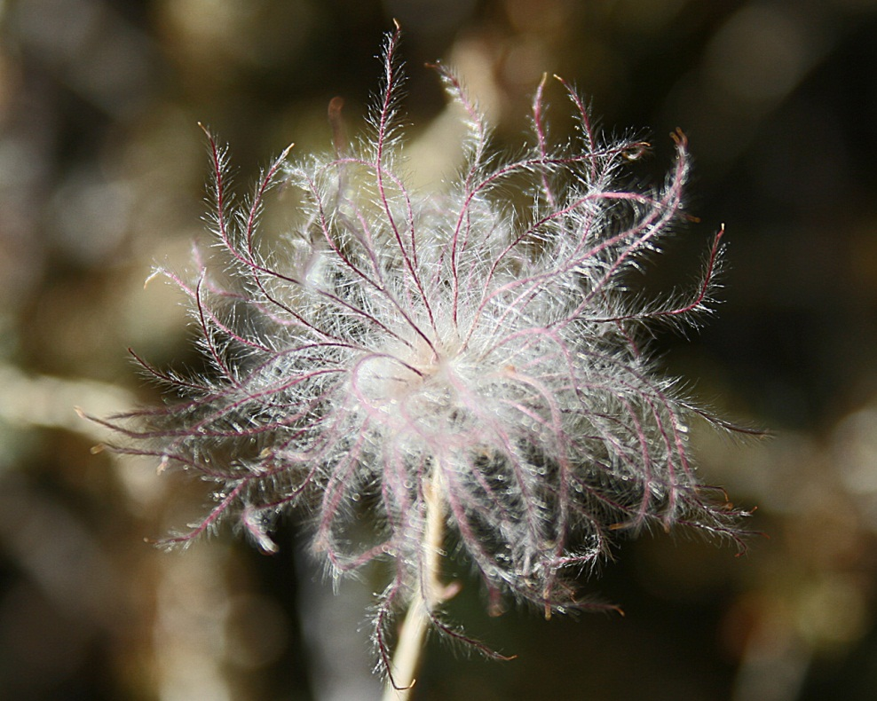
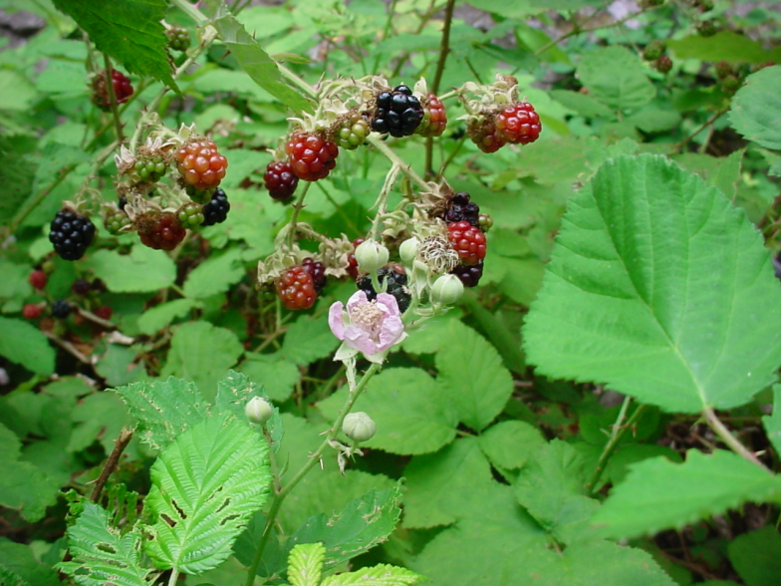
Rosids: Rosales: Rosaceae
Fragaria vesca
Fallugia paradoxa
Rubus discolor

Slide 20
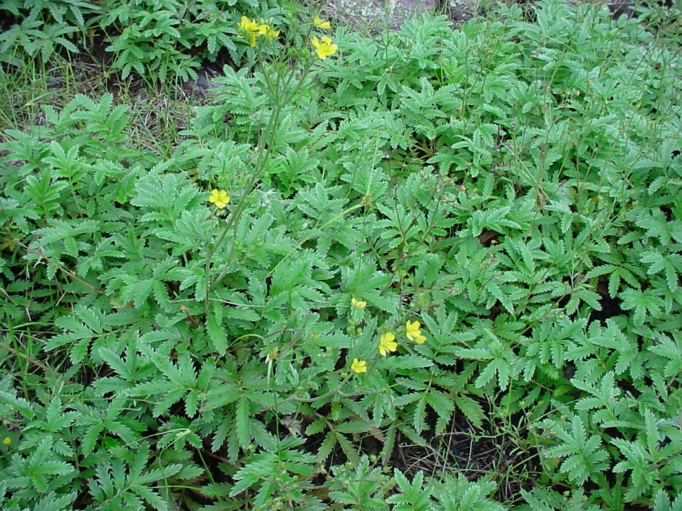
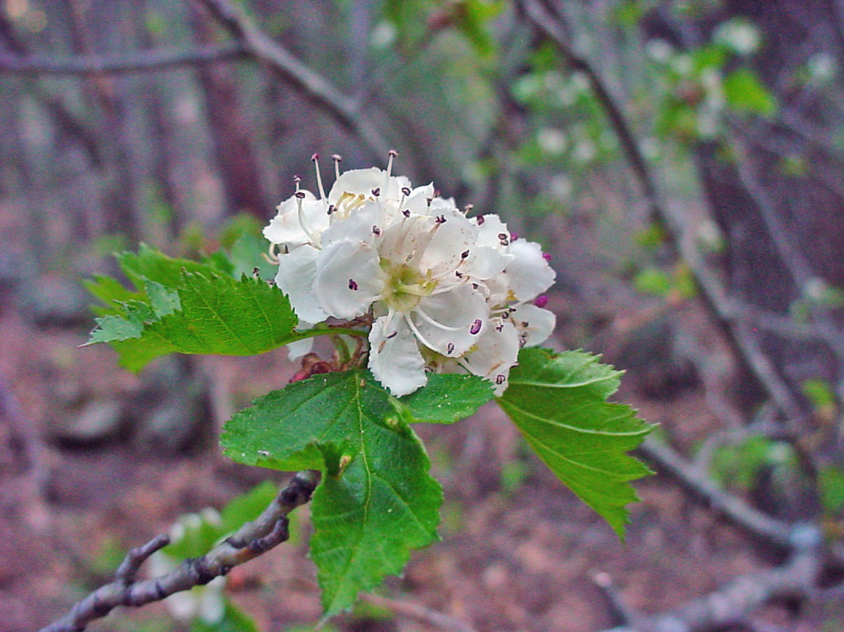
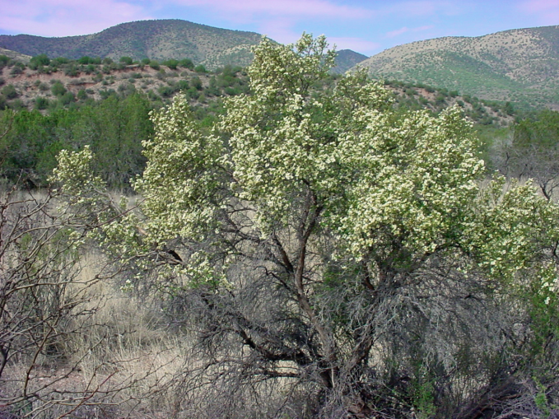
Rosids: Rosaceae– wide variety of growth form: herbs, shrubs, trees
Potentilla hippiana (herbaceous)
Crataegus wootoniana (tree)
Purshia stansburiana (shrub)

Slide 21
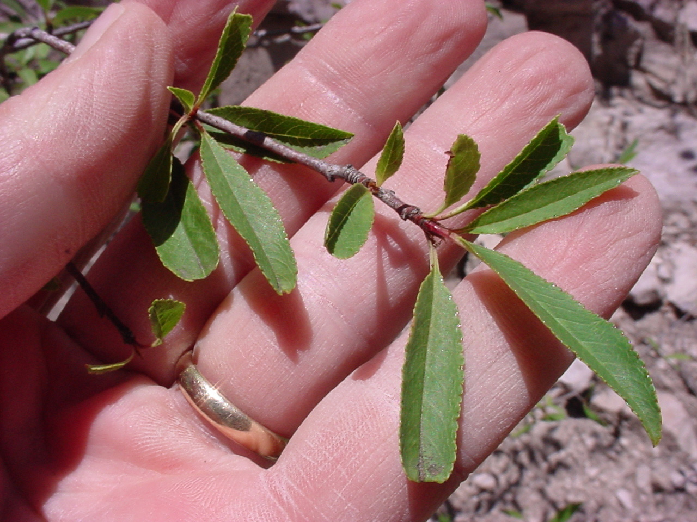
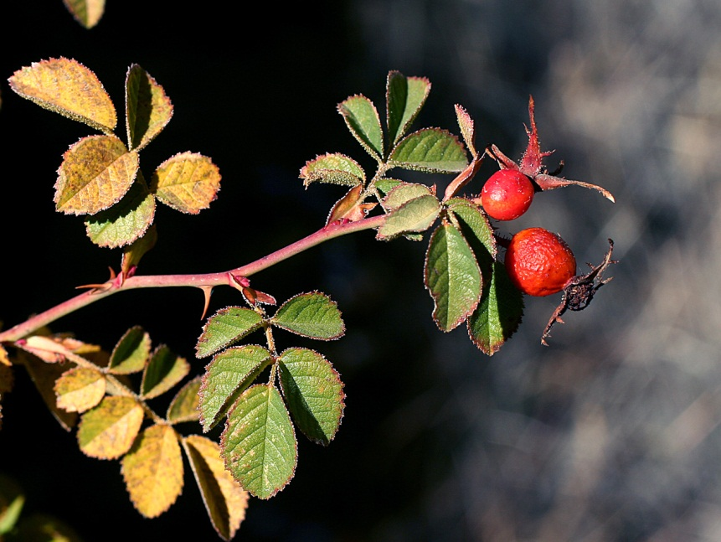
Rosids: Rosaceae– Leaves simple or compound, commonly toothed
Rosa woodsii– leaves compound and toothed
Prunus emarginata– leaves simple and toothed

Slide 22
Rosids: Rosaceae– Stipules usually present
Appendages (part of leaf) on either side of petiole base

Slide 23
Rosaceae– they have a Hypanthium (cuplike structure onto which the perianth and stamens attach)
No hypanthium here

Slide 24
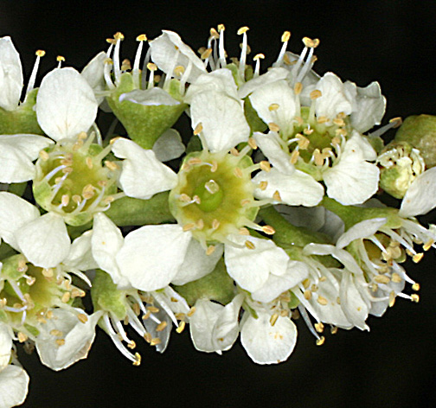
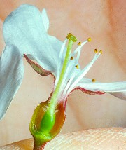
Rosaceae– Perigynous flower (hypanthium is free from superior ovary)
Prunus serotina (one carpel)

Slide 25
Rosaceae– Perigynous flower (ovary superior)
Fragaria– many carpels free from the hypanthium

Slide 26
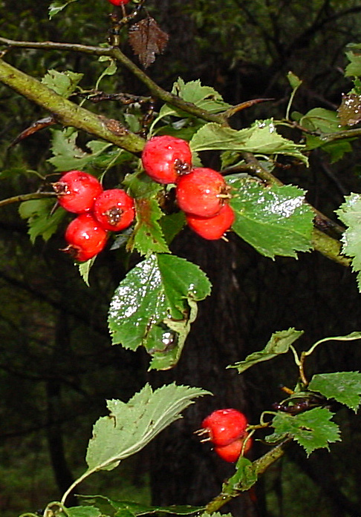
Rosaceae– Epigynous flower (hypanthium is adnate to inferior ovary)
Ovary not visible
Crataegus wootoniana
And as a result, the fruit usually has perianth parts remaining on expanded hypanthium

Slide 27
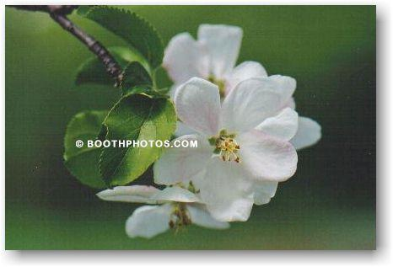
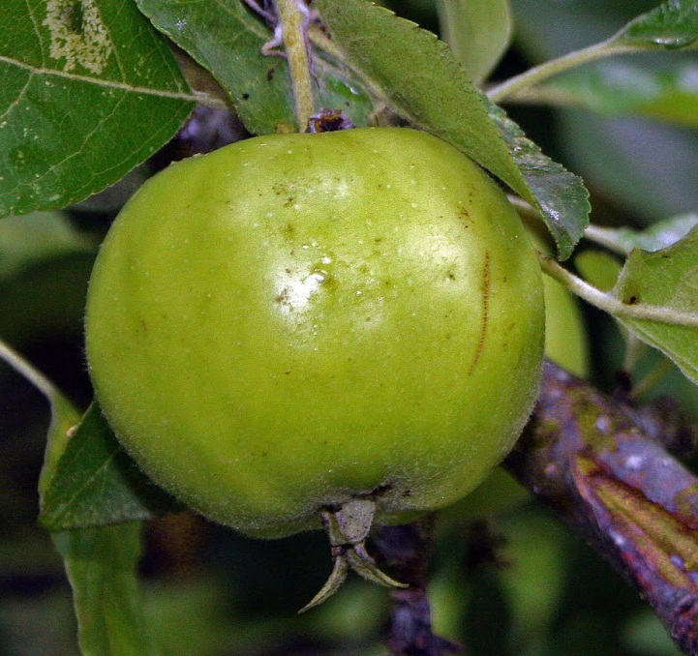
Rosaceae (Epigynous Flower– hypanthium is adnate to inferior ovary)
Malus (Apple)
Fruit with perianth parts on expanded hypanthium

Slide 28
Rosids: Rosaceae: Rosa woodsii
compound toothed leaves (but not in all Rosaceae), stipules obvious (most Rosaceae)
Foliage–
Calyx–
Corolla–
Androecium–
Gynoecium–
Fruit–
usually 5 sepals
Fused onto a hypanthium
usually 5 petals
many stamens
inferior with epigynous insertion in some genera, but can be superior in other Rosaceae with perigynous insertion
aggregate of achenes enclosed within hypanthium in Rosa…specialized fleshy fruits of other Rosaceae (e.g. apples, pears) called a “pome.”

Slide 29
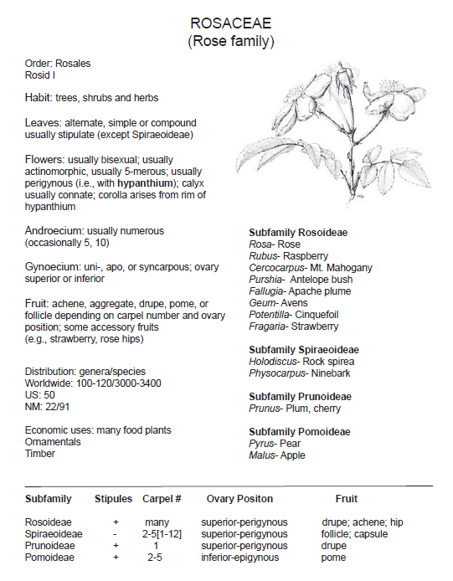

Slide 30
Hypothetical Relationships in Rosid Clade
Judd et al. 2016
Families in the Fabales in the Gila: Fabaceae & Polygalaceae.

Slide 31
Fabales
Fabaceae: Cologania angustifolia
Polygalaceae: Monnina wrightii

Slide 32
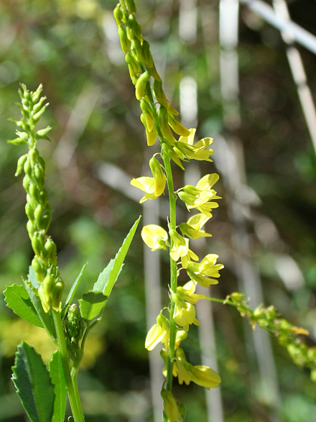
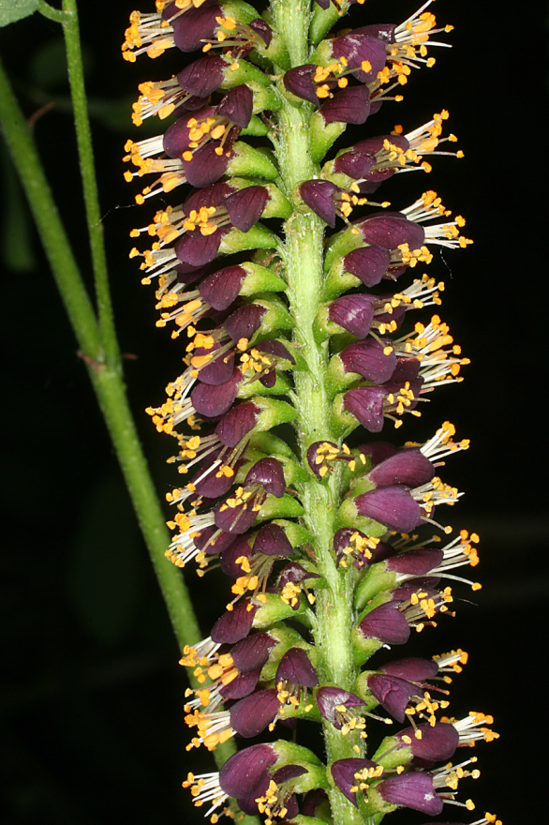
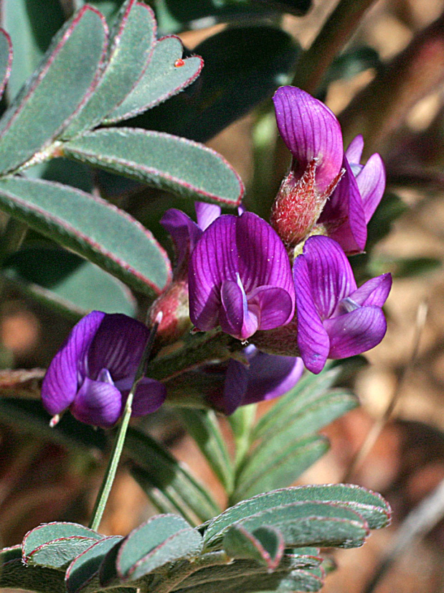
Rosids: Fabales: Fabaceae
Melilotus officinalis
Prosopis glandulosa
Amorpha fruticosa
Astragalus allochrous

Slide 33
Rosids: Fabales: Fabaceae
Vauchiella constricta
Caesalpinia gilliesii
Desmanthus cooleyi
Desmodium grahamii

Slide 34
Rosids: Fabales: Fabaceae Story of the Peanut
“Hypogaea means "under the earth", after pollination, the flower stalk elongates causing it to bend until the ovary touches the ground. Continued stalk growth then pushes the ovary underground where the mature fruit develops into a legume pod, the peanut.”
Text & pic from Wikipedia
Arachis hypogaea

Slide 35
Rhizobium– root nodules of Fabaceae often contain this nitrogen fixing bacterium
Rhizobium leguminosarum

Slide 36
Nitrogen Fixing Bacteria

Slide 37
Anabaena Azollae
Azolla mexicana
Anabaena azollae

Slide 38
Hosts and Symbionts

Slide 39
Rosids: Fabales: Fabaceae (Growth Form)
Gleditsia (Honey Locust)
Robinia (Locust)
(Thorns)
(Stipular spines)

Slide 40
Rosids: Fabales: Fabaceae: Leaves
Trifoliolate leaf: Trifolium wormskjoldii
Bifoliolate leaf: Prosopis glandulosa
Gleditsia triacanthos: twice pinnate
Robinia neomexicana: many leaflets in compound leaf

Slide 41
Rosids: Fabaceae: Flowers
All petals can be alike, or they can be differentiated into banner petal, 2 wing petals and 2 keel petals:
Lathyrus leucanthus
This type of flower called “papilionaceous”

Slide 42
Rosids: Fabaceae: Flowers
Vicia americana– Diadelphous stamens
Sophora nuttalliana– all filaments distinct

Slide 43
Rosids: Fabaceae (Flowers)
Papilionaceous Flower

Slide 44
Rosids: Fabaceae (Flowers)
Mimosa (Wait-a-Bit)

Slide 45
Rosids: Fabaceae (Flowers)
Prosopis (Mesquite)

Slide 46
Rosids: Fabaceae: Fruit= Legume (or Pod)
Calliandra humilis
Caesalpinia gilliesii
Cologania angustifolia
Robinia
neomexicana

Slide 47
Rosids: Fabaceae: Fruit= Legume (or Pod)
Prosopis glandulosa

Slide 48
Mequite as Food
Traditionally, Native peoples in the Southwest depended on mesquite. It provided food, fuel, shelter, weapons, medicine, and cosmetics. As times changed, and as refined sugar and wheat flour became staples, the role of mesquite was diminished. Mesquite meal, made by grinding the seeds and pods, Modern milling techniques grind the entire mesquite pod, including most of the protein-rich seed. This produces a meal that is highly nutritious as well as flavorful. The meal ground from the pod contains 11 to 17 percent protein. A high lysine content makes it the perfect addition to other grains that are unusually low in this amino acid.

Slide 49
Rosids: Fabaceae: Specialized type of legume= loment
LOMENT has constrictions between the cells in which the seeds sit
Desmodium grahamii

Slide 50
Rosids: Fabaceae: Vicia americana
Papilionaceous flower
Pinnately compound leaves
Lathyrus
Vicia
Fabaceae: always ONE carpel. Stigmatic region on Vicia hairy in a tuft below the apex, rather than all the way down the style as in Lathyrus.

Slide 51
Rosids: Fabaceae: Vicia americana
Foliage--
Calyx--
Corolla–
Androecium–
Gynoecium–
Fruit–
pinnately compound in Vicia (but trifoliolate in others)
5 sepals, connate
papilionaceous
diadelphous 9+1
one carpel, ovary superior
Legume (dry, elongate fruit from a single carpel that opens along two longitudinal sutures)

Slide 53
Eudicots: Rosids (Malvids): Brassicaceae
Hesperidanthus linearifolius
Physaria fendleri
Draba cuneifolia, note basal rosette common in Brassicaceae

Slide 54
Hypothetical Relationships in Rosid Clade
Judd et al. 2016

Slide 55
Eudicots: Rosids: Brassicaceae:

Slide 56
Eudicots: Rosids: Malvids: Brassicaceae
Other cultivar groups of Brassica oleracea include cabbage (Capitata Group), cauliflower (Botrytis Group), kale and collard greens (Acephala Group), kohlrabi (Gongylodes Group), and Brussels sprouts (Gemmifera Group). Chinese broccoli (Alboglabra Group) is also a cultivar group of Brassica oleracea.^{[19]}

Slide 57
Eudicots: Rosids: Brassicaceae
Physaria fendleri, tetradynamous stamens easily visible
Tetradynamous stamens→ 6 stamens, with the 2 outer ones shorter than the 4 inner ones. Sometimes all about the same length.
Perianth: 4 sepals, 4 petals

Slide 58
Eudicots: Rosids: Brassicaceae
Erysimum capitatum
Tetradynamous stamens– 4 long, 2 short stamens

Slide 59
Eudicots: Rosids: Brassicaceae (Fruits)
Lepidium lasiocarpum: silicle
Hesperidanthus linearifolius: silique
Silique
Claw & Limb

Slide 60
Eudicots: Rosids: Brassicaceae
Foliage--
Calyx–
Petals–
Androecium--
Gynoecium–
Fruit–
basal rosette common, leaves entire to lobed or dissected
4 sepals, distinct (aposepalous)
4 petals, distinct (apopetalous)
Tetradynamous to +/- same length
2 connate carpels, ovary superior, stigma capitate
silicle or silique (special type of capsule)

Slide 62
Hypothetical Relationships in Rosid Clade
Judd et al. 2016

Slide 63
Eudicots: Rosids: Malvaceae
Hibiscus
Sphaeralcia
Alcea

Slide 64
Eudicots: Rosids: Malvaceae
Abelmoschus
(Okra)

Slide 65
Eudicots: Rosids: Malvaceae
Fibers surround the seeds inside the capsule (called the boll.)
A cotton boll contains 27 to 45 seeds and each seed grows between 10,000 and 20,000 hairs or fibers. Each fiber is a single cell, 3,000 times longer than wide. The fibers develop in two stages. First, the fibers grow to their full length (in about three weeks). For the following three to four weeks, layers of cellulose are deposited
http://science.jrank.org
Gossypium (Cotton)

Slide 66
Eudicots: Rosids: Malvaceae
5 sepals
5 petals
Monadelphous stamens: filaments strongly connate and forming a tube around the gynoecium

Slide 67
Eudicots: Rosids: Malvaceae
Fruits
Loculicidal capsule, each seed surrounded by hairs
Gossypium
Sphaeralcea
Schizocarps
Loculicidal capsule
Alcea
Hibiscus

Slide 68
Eudicots: Rosids: Malvaceae
Foliage with stellate hairs

Slide 69
Eudicots: Rosids: Malvaceae
Foliage–
Calyx–
Corolla–
Androecium–
Gynoecium–
Fruit–
stellate hairs
5 distinct sepals
5 distinct petals
monadelphous stamens (many)
many connate carpels, ovary superior
loculicidal capsule or schizocarp
Schizocarp→ dry fruit formed from multiple carpels and breaking into one seeded or few seeded segments between the carpels

Slide 71
Hypothetical Relationships in Rosid Clade
Judd et al. 2016

Slide 72
Lots of other important Rosid families
Cucurbitaceae
Fagaceae
Quercus emoryi
Quercus gambelii

Slide 75
On to the Superasterids…!

